Slide 1
CLIMATE CHANGE BELIEF ANALYSIS USING MACHINE LEARNING MODEL
Presented by Royalux
30 JUNE 2022

Slide 2
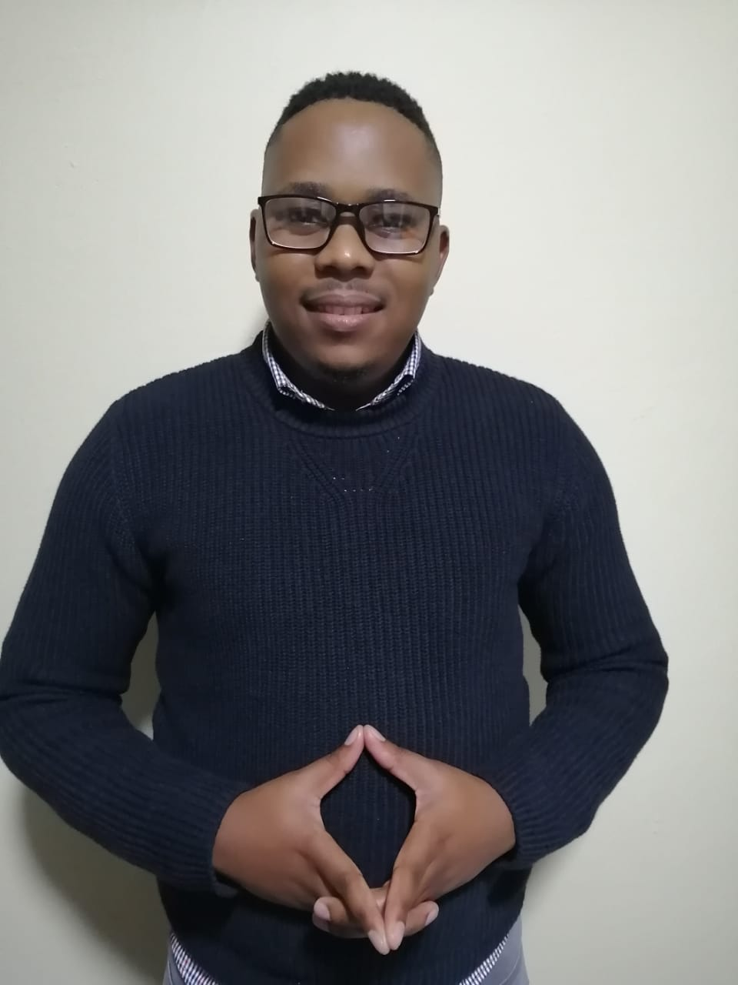
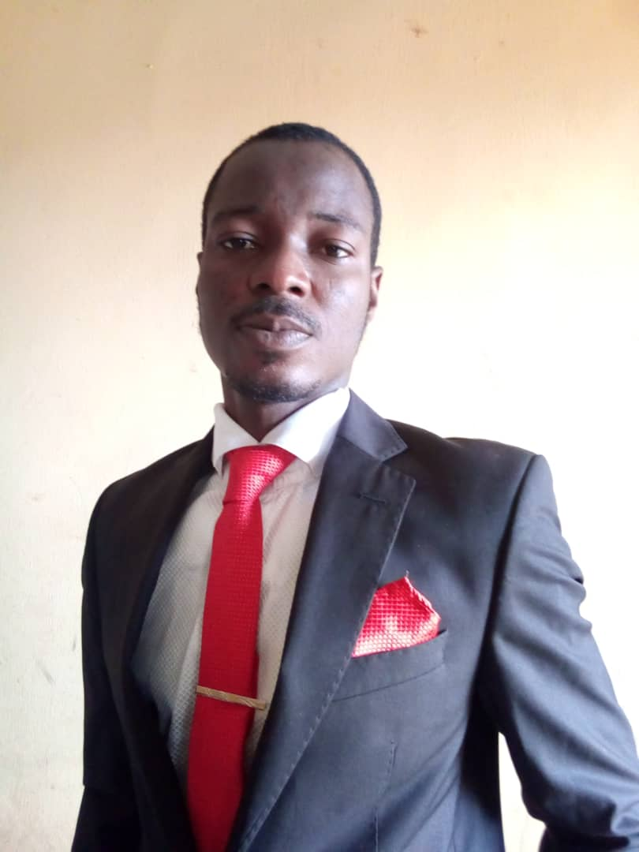
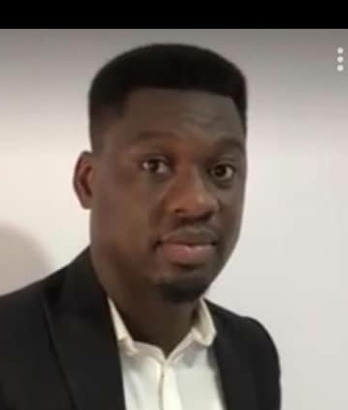
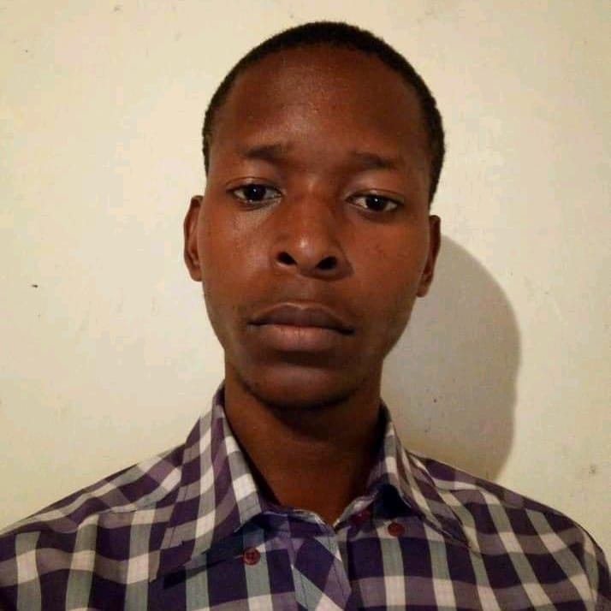

OUR TEAM MEMBERS
Odukoya
Daniel
Administrator
Adebayo Salaudeen
Project director
Thapelo
Mofokeng
Business developer
Samson
Oguntuwase
MD
Jeff Ouma
Tech.head

Slide 3






OUTLINE
Introduction
Problem statement
Exploratory data analysis
Data engineering
Model exploration
Application demonstration
Conclusion

Slide 4
EXECUTIVE SUMMARY
Royalux has been in the consulational business space for over 2 decade.
Our staffs are well trained both locally and internationally.
We have adept teams in developing accurate predictive model.
We have reputable clients across the globe.

Slide 5

INTRODUCTION
Climate change
Natural process
It’s real and needs serious attention
It’s a hoax
Believers
Deniers

Slide 6

INTRODUCTION…
Twitter
A social media platform with 328 million monthly active users.
Best platform to collect people’s opinions about various topics.
Twitter data to understand the trends of user’s opinions.

Slide 7
INTRODUCTION…
This design is intended to give client the predictive tool for an oversight on how individual disposition affects the business landscape.
Datasets
Canada Foundation for Innovation JELF Grant to Chris Bauch, University of Waterloo.
The dataset was collected between Apr 27, 2015 and Feb 21, 2018.
Total of 43943 tweets.
Classes: Anti (-1), Neutral (0), Pro(1) & News(2).

Slide 8

PROBLEM STATEMENT
USING TWITTER TO MEASURE THE IMPACT OF CLIMATIC CHANGE
Find characteristic differences between climate change believers and deniers
http://www.uowblogs.com/dmpf808/2017/05/08/the-problem/

Slide 9
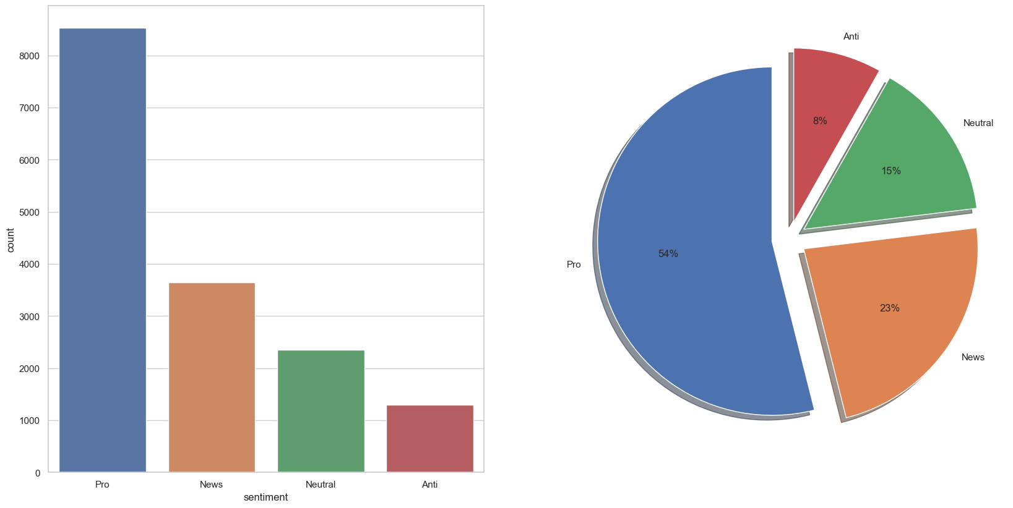
EXPLANATORY DATA ANALYSIS
The dataset has been viewed and this was discovered.
Sentiments
Anti
Correctly formatted data.
Correct data type.
No null values present.
No collinearity nor multi-collinearity.
8 %
Neutral
Pro
15 %
54 %
23 %
News

Slide 10
EXPLANATORY DATA ANALYSIS…
message feature
#hashtags

Slide 11
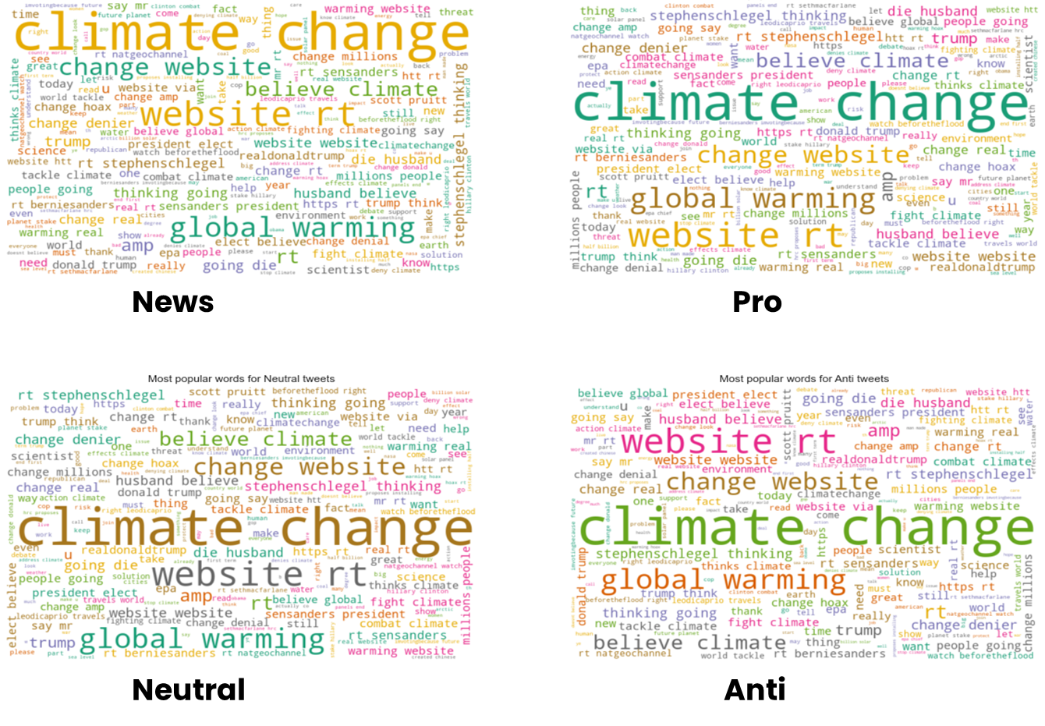
DATA ENGINEERING…

Slide 12

DATA ENGINEERING
The following processes were carried out on the data :-
Removal of web-url from the dataset.
Converting all text to lowercase.
Word Tokenization.
Stopword removal.
Word Stemming.
Building Pipeline.
https://www.dataversity.net/data-scientist-vs-data-engineer/

Slide 13
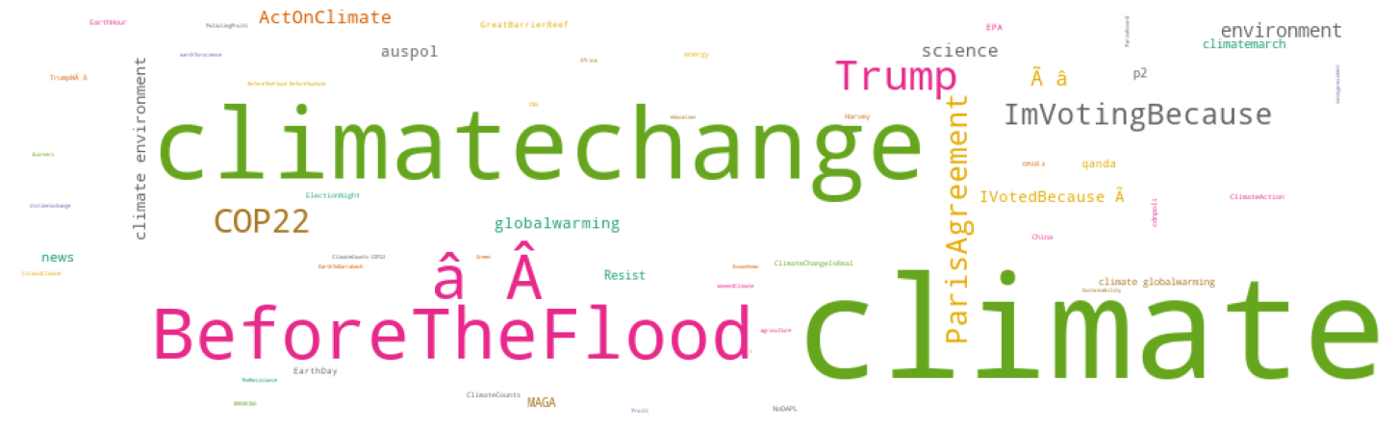
DATA ENGINEERING…

Slide 14
MODELLING
Listed below are different models were sampled.
RandomForest.
K-nearest Neighbour.
Logistic Regression.
Support Vector.
Decision tree
AdaBoost.
RBF SVC.
Linear SVM.

Slide 15
MODEL EXPLORATION
Several strategies like: data processing techniques, data balancing , cross validation and grid search we done to improve the model performance.
All the model performed better on the uncleaned data.

Slide 16
MODEL EXPLORATION…
Data balancing yielded little to no improvement in the model.
A few models that were tried resulted in overfitting.

Slide 17
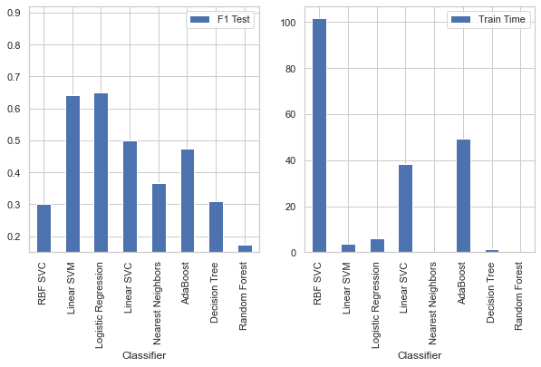
MODEL EXPLORATION…

Slide 18
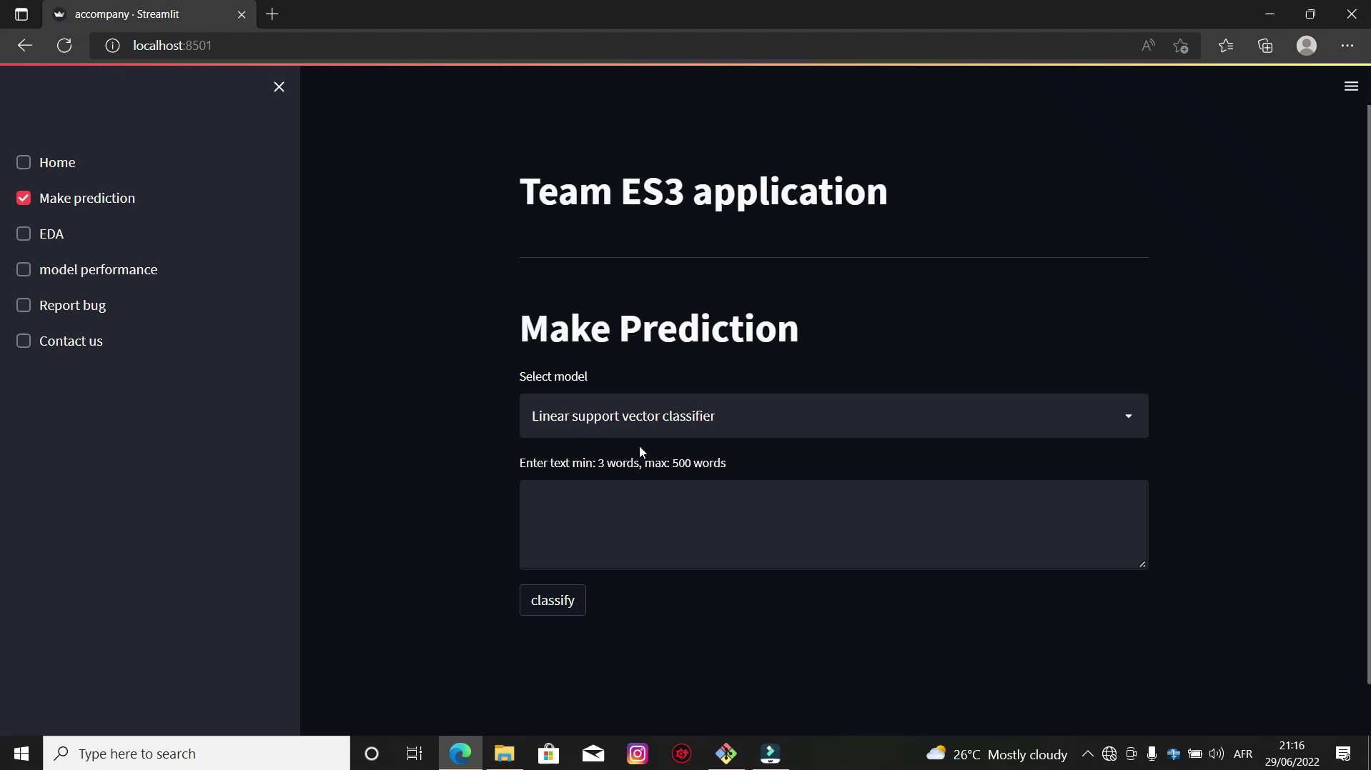
APPLICATION DEMO.

Slide 19
CONCLUSION
More than half of the tweets examined support the belief of man-made climate change.
This is not surprising since the impacts of climate change are global in scope and unprecedented in scale.

Slide 20
CONCLUSION
Majority of anti climate change tweets come from Republicans and Trump supporters.
It is probably significant to say that climate change is generating serious contending issues in the United State of America.

Slide 21
RECOMMENDATIONS
It would probably be best to tailor a message to change that does not emphasize the environmental friendliness and sustainability aspects of the products and services, but rather a message that speaks to product features and price etc, would be the best approach when targeting this group..

Slide 22
RECOMMENDATIONS…
The formation of potential partnerships with several of the organisations mentioned in the tweet for pro could lead to brand exposure with individuals who in their daily lives make conscious decisions with regards to the products and services they purchase.
We recommend that the latter strategy of pursuing partnerships with like minded organisations will yield the best results, in terms of finding a group of potential customers who share the same values and ideals, and would be likely to purchase your products and services.

Slide 23
THANK YOU!
TEAM ES3
Customer care cell number
678-555-0143
Email
Team_es3@royalux.com

